Slide 1
POWER BI PROJECT IN EMPLYEE ATTRITION
NAME:R.LOGESH
COURSE:DA&DS
DATE:26/02/2025

Slide 2
INTRODUCTION:
The employee attrition train refers to a dataset used for predicting employee Characteristics in a company.
This dataset helps the management to know about the employee attrition in the company like years of working,salary,performance and so on.
From this dataset we can able to predict whether an employee is likely to stay or leave, based on various influencing factors such as job satisfaction, tenure, compensation, and other workplace dynamics

Slide 3
FACTORS IN THE EMPLOYEE ATTRITION:
To identify the employee attrition in the company factors that have used are:
Education Field
Age
Department
Environment Satisfication
Job Involvement and so on.

Slide 4
DATA CLEANING AND TRANSFORMATION:
Data Collection:
-> To understand about the raw dataset
Handling Missing values:
-> Missing data that occurs in the dataset
Correcting Dataset:
->Remove Duplicates values
->Created new column for Analysis.

Slide 5
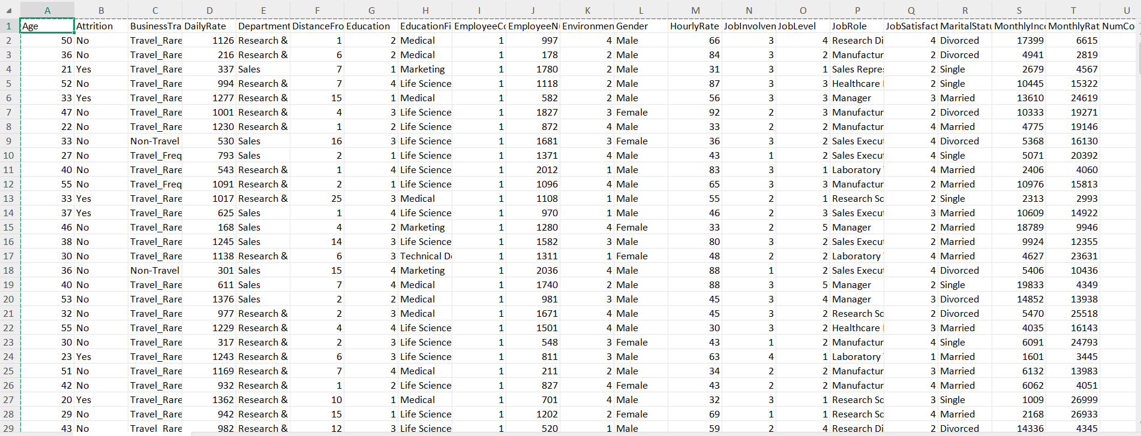
DATASET AFTER CLEANING:

Slide 6
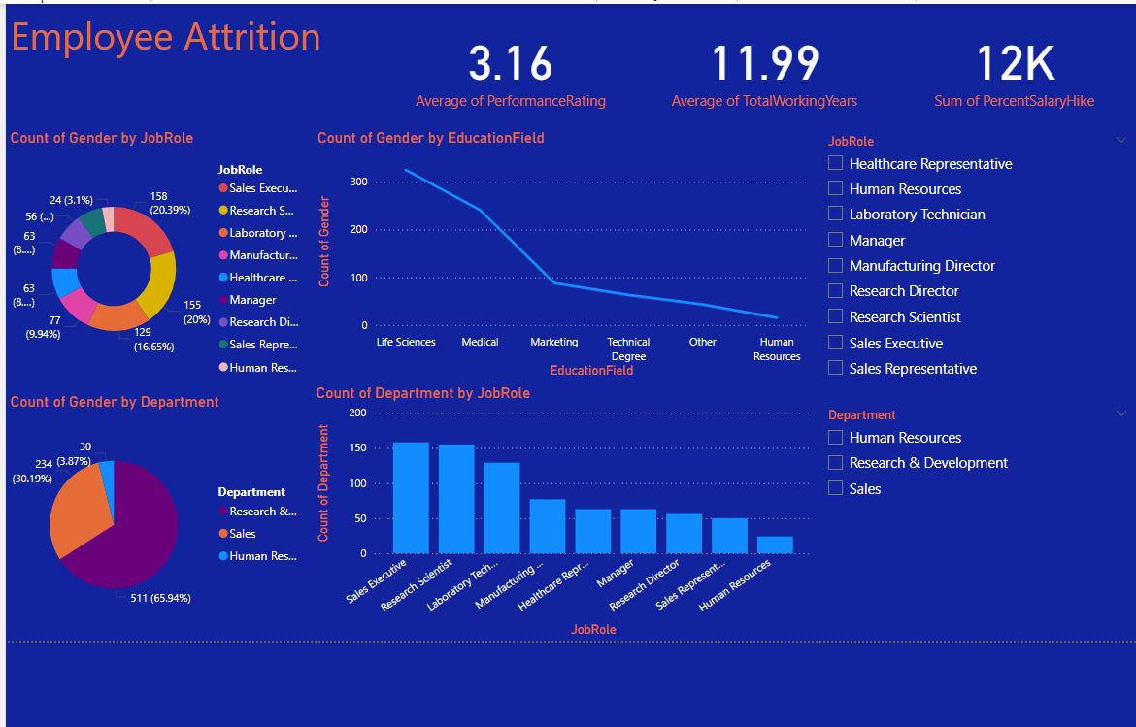
DASHBOARD:

Slide 7
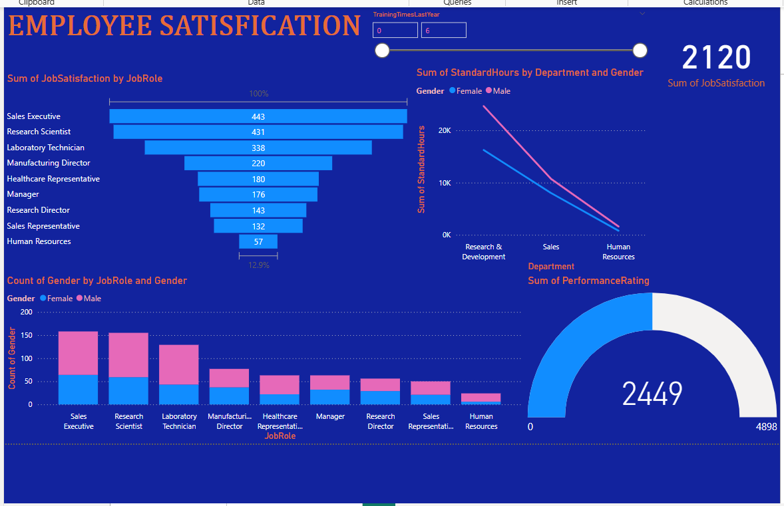
DASHBOARD

Slide 8
INSIGHTS:
JOB ROLE:RESEARCH DIRECTOR HAVE HIGHEST OF ATTRITION
EDUCATION FIELD:LIFE SCIENCE HAVE HIGHEST OF ATTRITION
MALE GENDER HAVING THE HIGHEST PRIORITY IN OVER TIME OF WORKING
EMPLOYEE WHO HAVE GIVEN 3 POINTS HAVE THE HIGHEST OF ATTRITION AND ALSO IN JOB INVOLVEMENT
EMPLOYEE HAVE HIGHEST PRIORITY IN DEPARTMENT OF RESEARCH AND DEVELOPMENT AS COMPARED TO THE ANOTHER TWO DEPARTMENT

Slide 9
THANK YOU

